Slide 1
Pingdom Testing Tool
Optimizing Performance & Reliability

Slide 2
INTRODUCTION
Pingdom is a powerful website monitoring and performance optimization tool designed to ensure that your online presence runs smoothly and efficiently. Developed by SolarWinds, a trusted name in IT management solutions, Pingdom has established itself as a leading platform for monitoring website uptime, analyzing performance metrics, and identifying potential issues before they impact users.

Slide 3
How to test website using pingdom tool

Slide 4
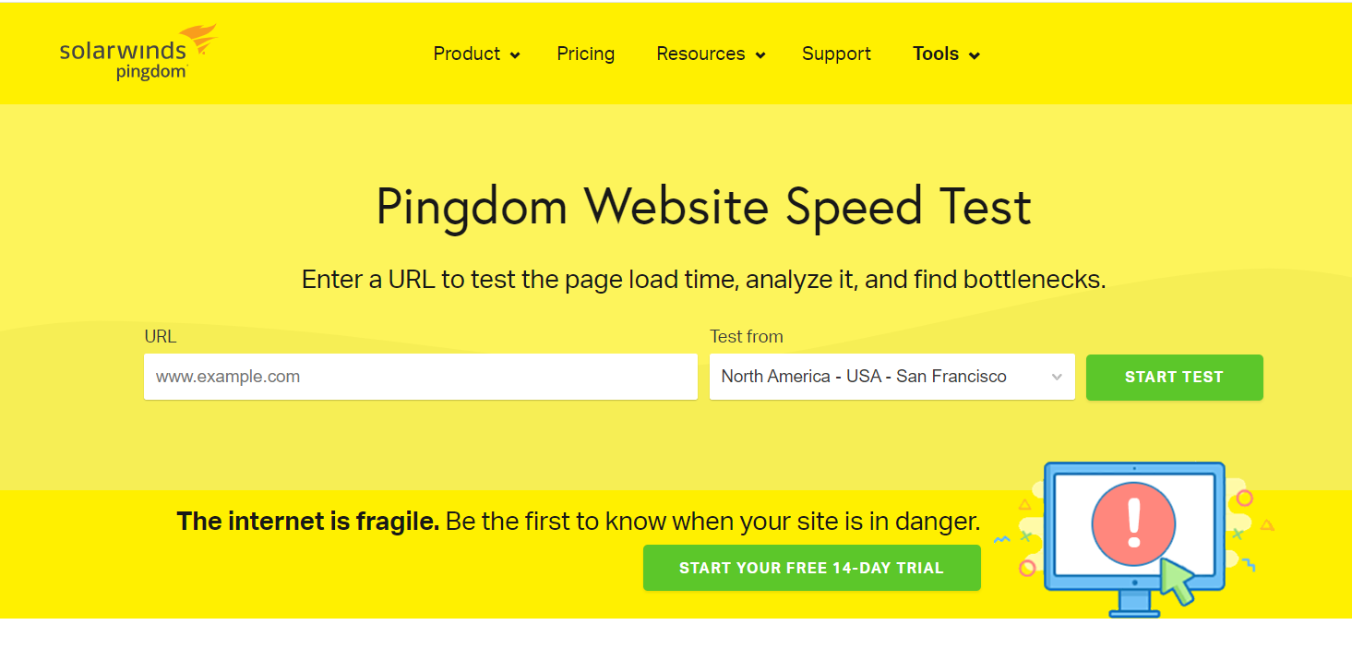
Open Pingdom testing tool in the browser.

Slide 5
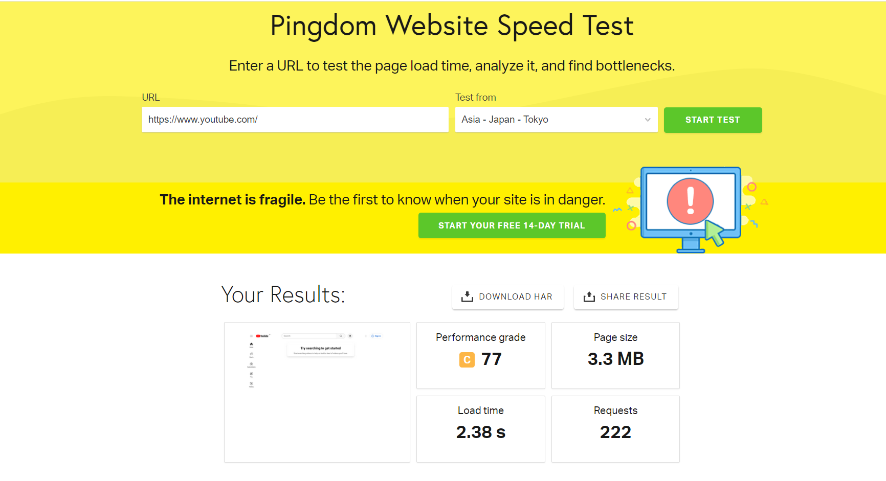
Copy the URL of the website to test and paste in the tool

Slide 6
Performance grade:
The performance grade is a score given to your website based on various performance metrics. It reflects how well your website is optimized and how efficiently it delivers content to users. The grade is typically given as a letter (A, B, C, etc.) Along with a numerical value (out of 100). In this case, the performance grade is C77, indicating a moderate level of performance.
Page size:
page size refers to the total size of all elements (HTML, CSS, javascript, images, etc.) That need to be downloaded by a browser to display a web page. It is measured in megabytes (MB) or kilobytes (KB). A larger page size generally results in longer load times and may impact website performance, especially for users with slower internet connections or mobile devices. In this case, the page size is 3.3 MB, which is relatively large and could potentially be optimized to improve performance

Slide 7
Load time:
Load time, also known as page load time or response time, is the amount of time it takes for a web page to fully load in a user's browser after they request it. It is measured in seconds (s) or milliseconds (ms). Load time is a critical metric for user experience, as faster load times typically lead to higher user satisfaction and lower bounce rates. In this case, the load time is 2.38 seconds, which is relatively fast but could potentially be further optimized for better performance.
Requests:
Requests refer to the number of HTTP requests made by the browser to load all the elements of a web page, including HTML files, images, CSS stylesheets, javascript files, and other resources. Each element on a web page typically requires a separate HTTP request, so reducing the number of requests can help improve page load times and overall performance. In this case, there are 222 requests made to load the web page, which is relatively high and could potentially be reduced through optimization techniques such as combining files, using sprites, or lazy loading.

Slide 8
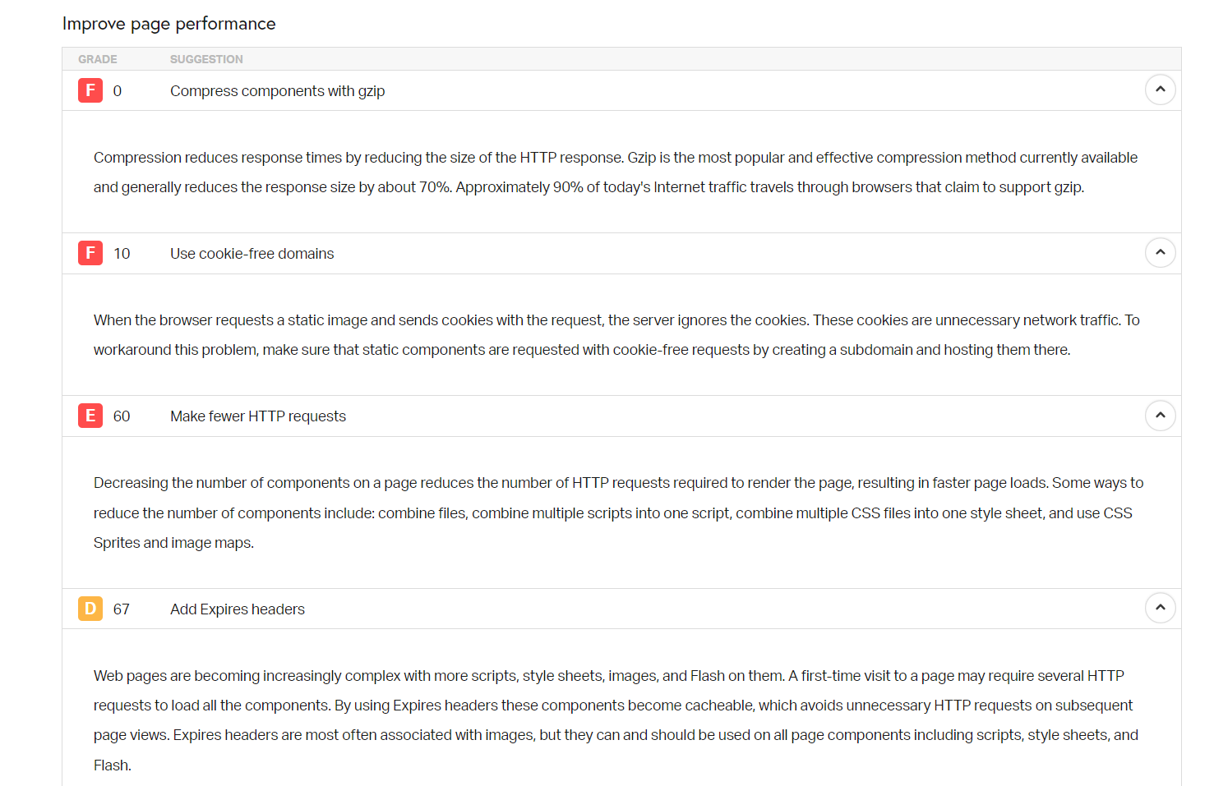
This tool gives the suggestions to improve the page performance

Slide 9
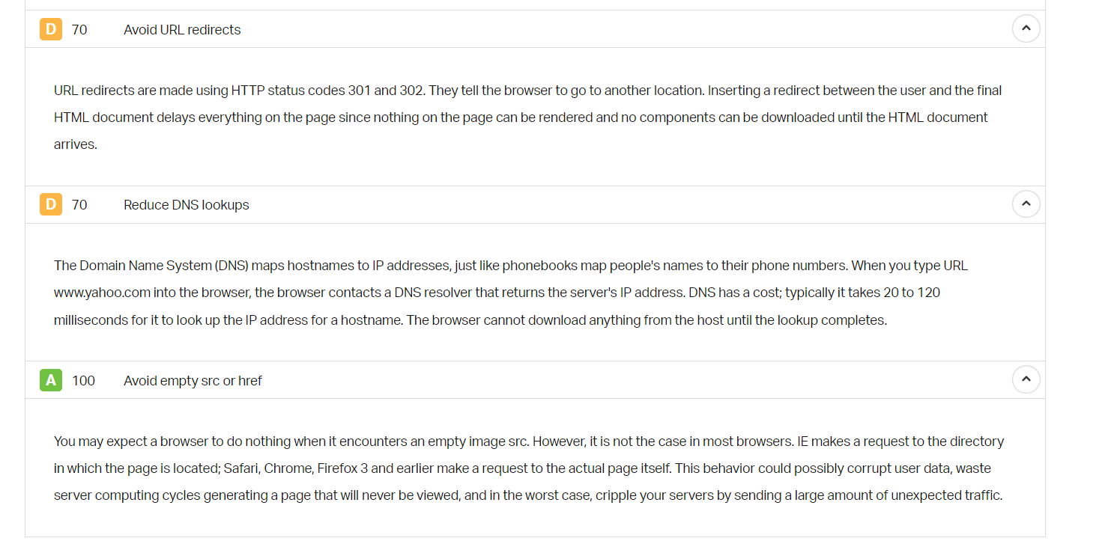

Slide 10
Conclusion
In conclusion, Pingdom is an indispensable tool for monitoring website performance, ensuring uptime, and optimizing user experience. Its real-time insights and comprehensive features empower businesses to proactively address issues, improve performance, and ultimately enhance their online presence. By incorporating Pingdom into your website management strategy, you can achieve greater reliability, efficiency, and success in today's digital landscape.

Slide 11
THANK YOU

